Slide 1
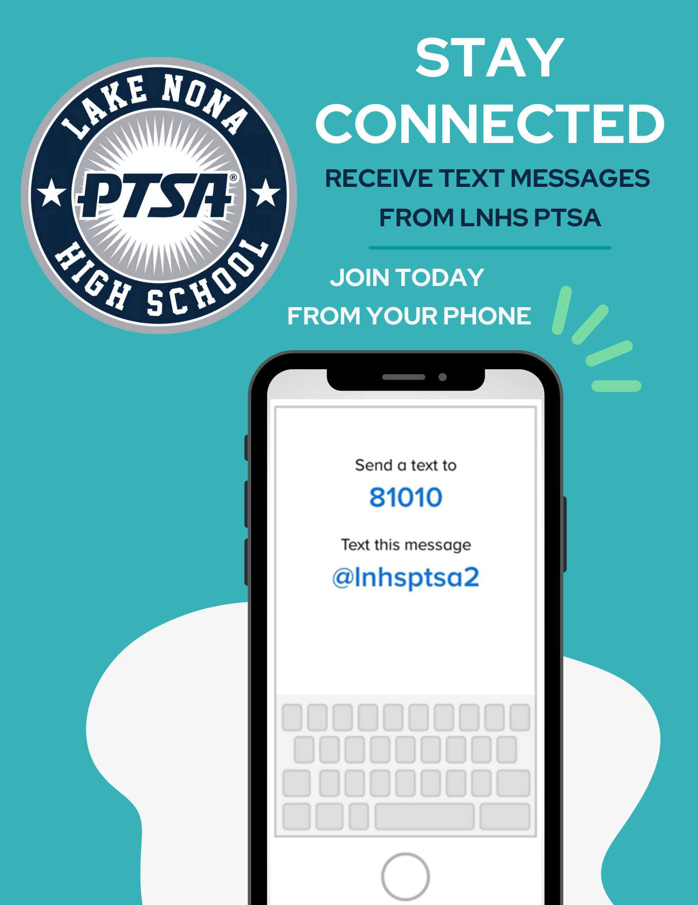
WELCOME
LNHS PTSA GENERAL MEETING
WEDNESDAY
JANUARY 15, 2025
6:30PM
MEDIA CENTER
www.LNHSPTSA.com

Slide 2
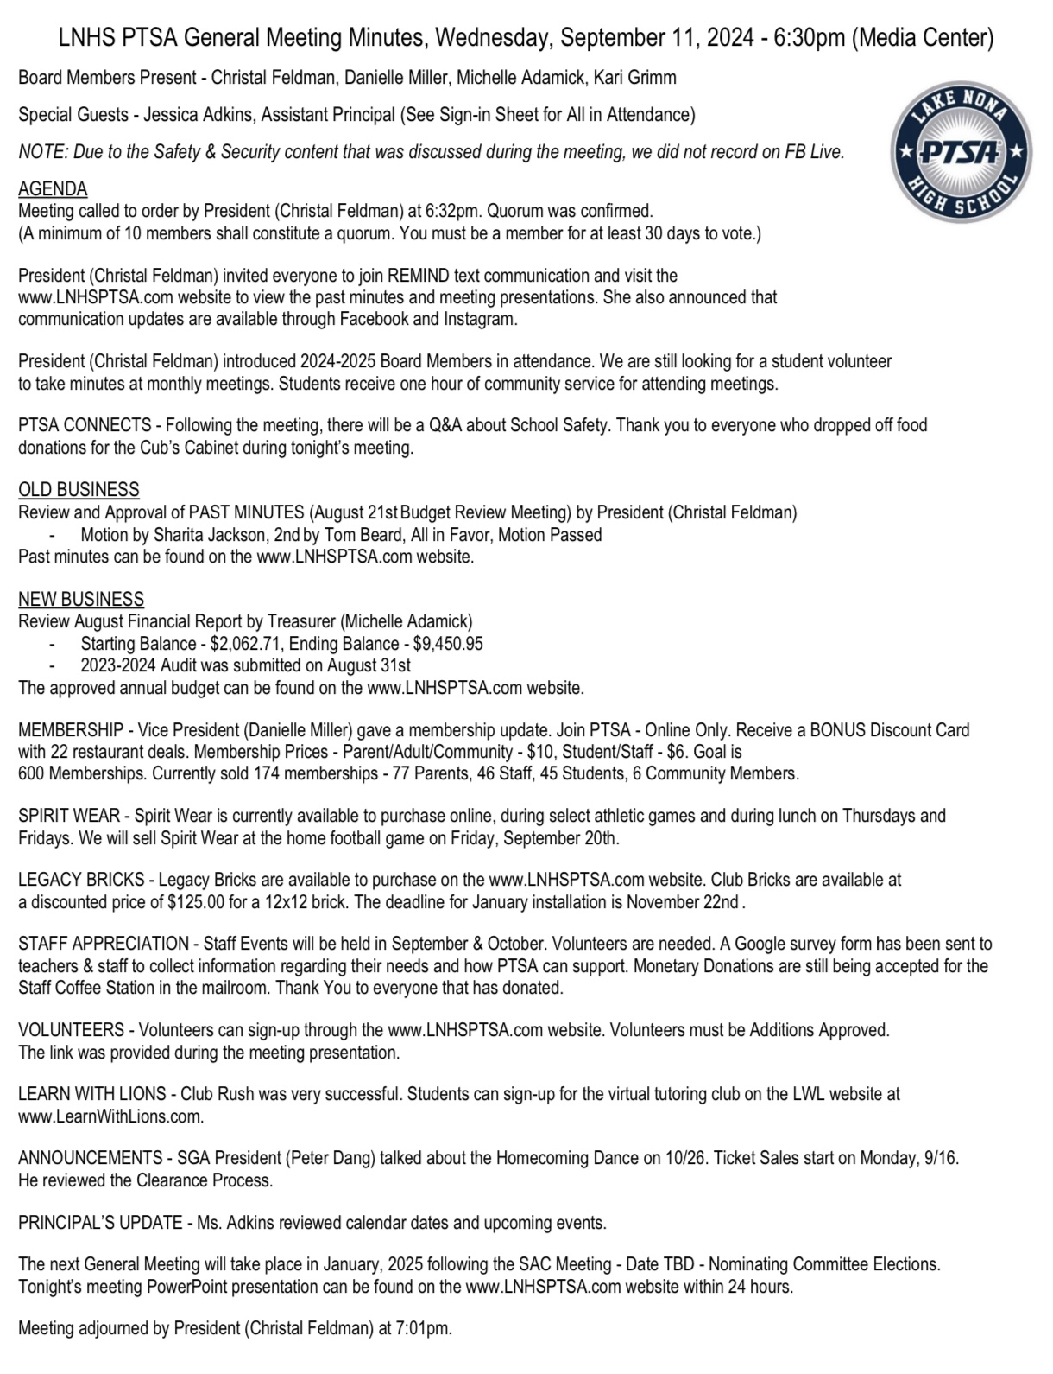
PAST MINUTES
SEPTEMBER 11, 2024 FOR APPROVAL

Slide 3
DECEMBER
FINANCIAL
REPORT Starting Balance - $5,523.82
Ending Balance - $5,893.58

Slide 4
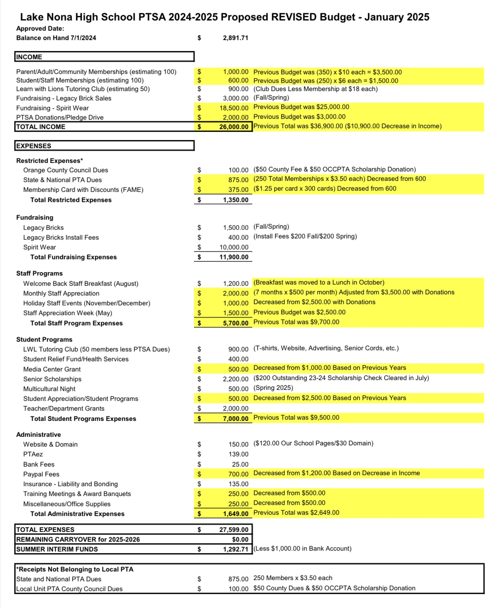
PROPOSED
REVISED
2024 - 2025
ANNUAL BUDGET FOR APPROVAL

Slide 5
NOMINATING COMMITTEE ELECTIONS

Slide 6
Help Us Meet Our Goal of 250 Memberships!
Parents - 92, Staff - 54, Students - 82, Community - 7
235 Memberships

Slide 8
LEGACY
BRICKS
Fall Installation
Late January/Early February
Spring Deadline
Friday, April 4, 2025

Slide 9
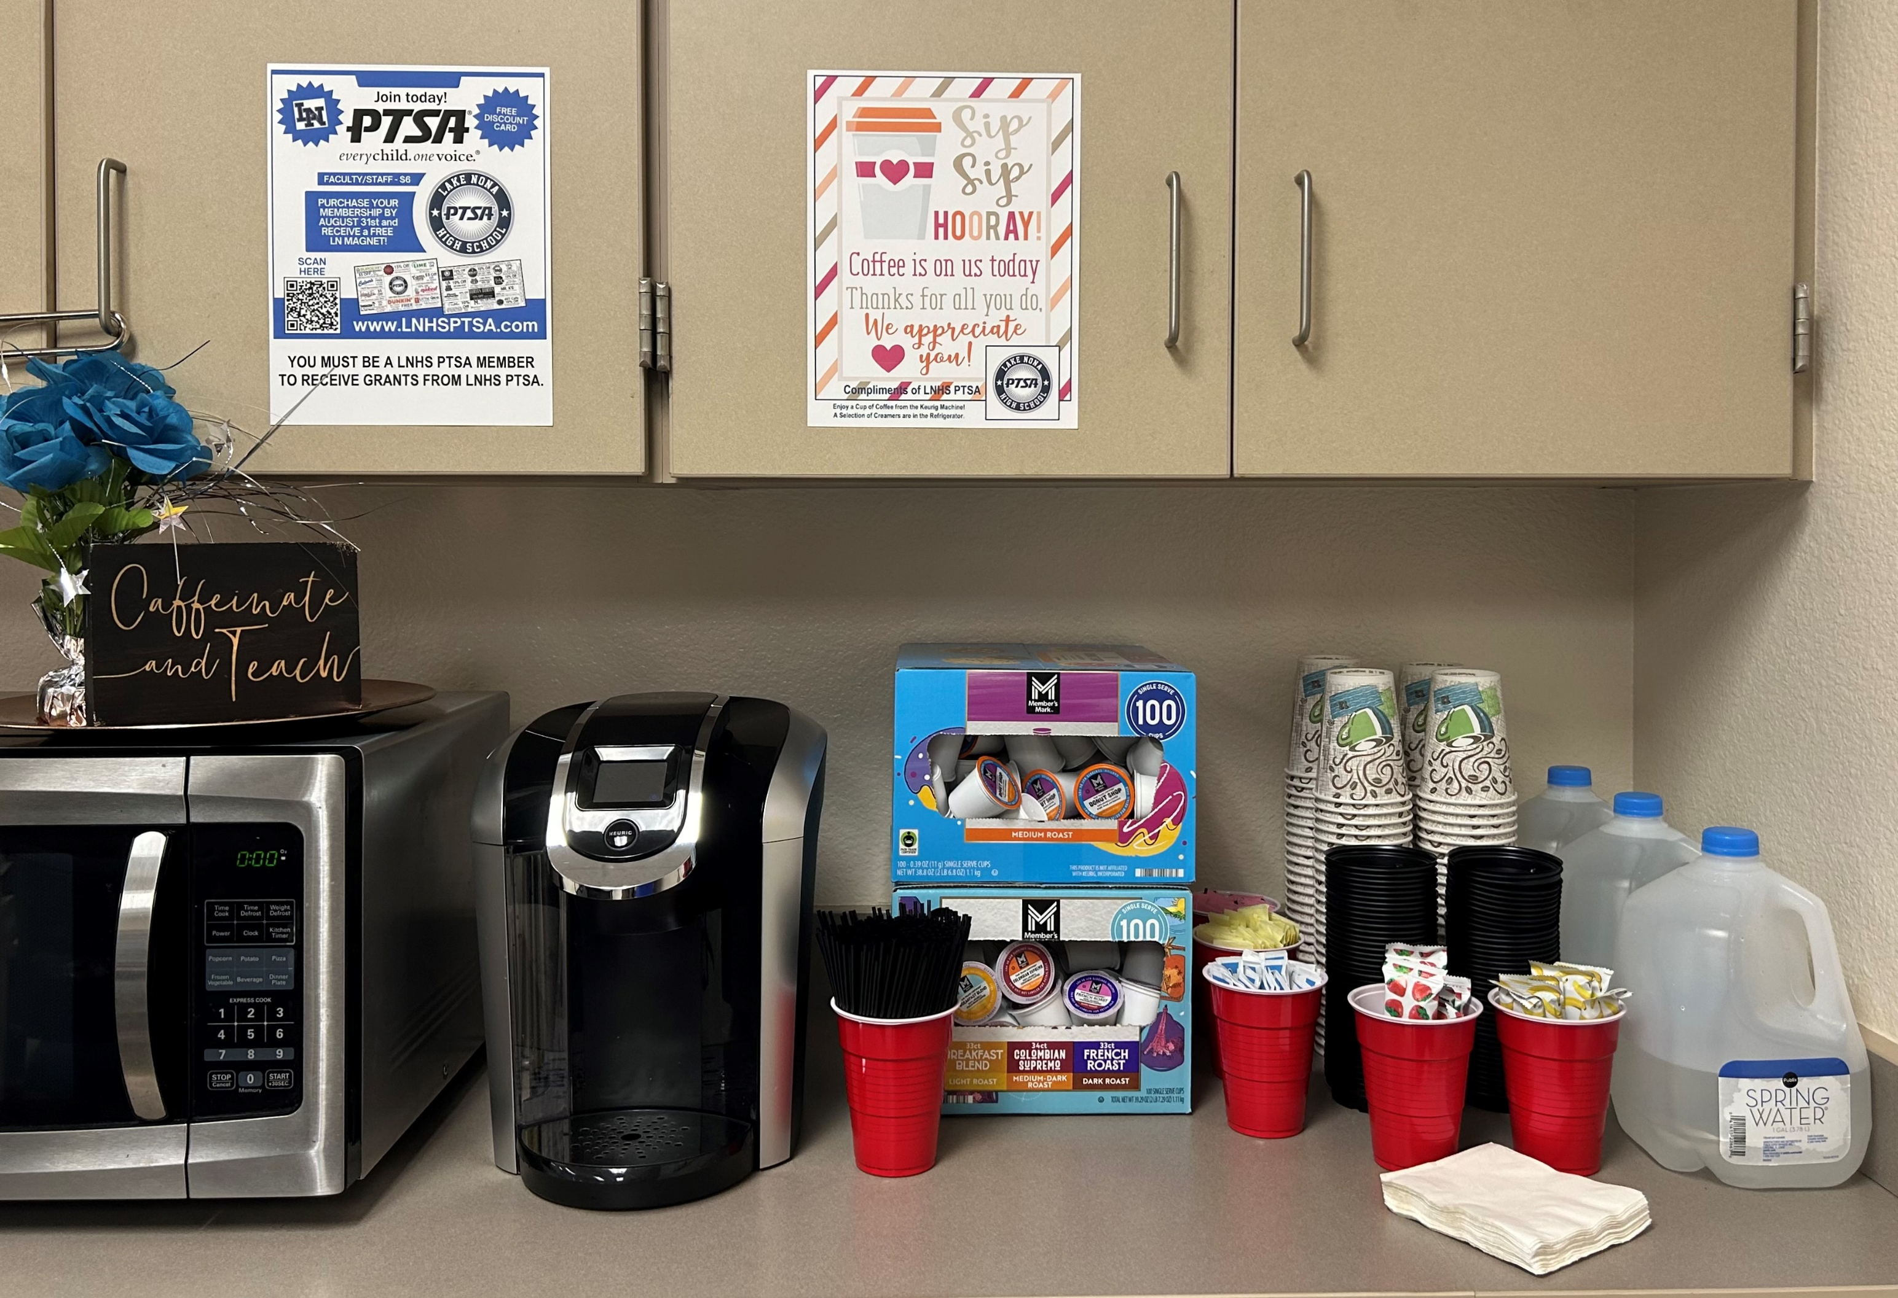
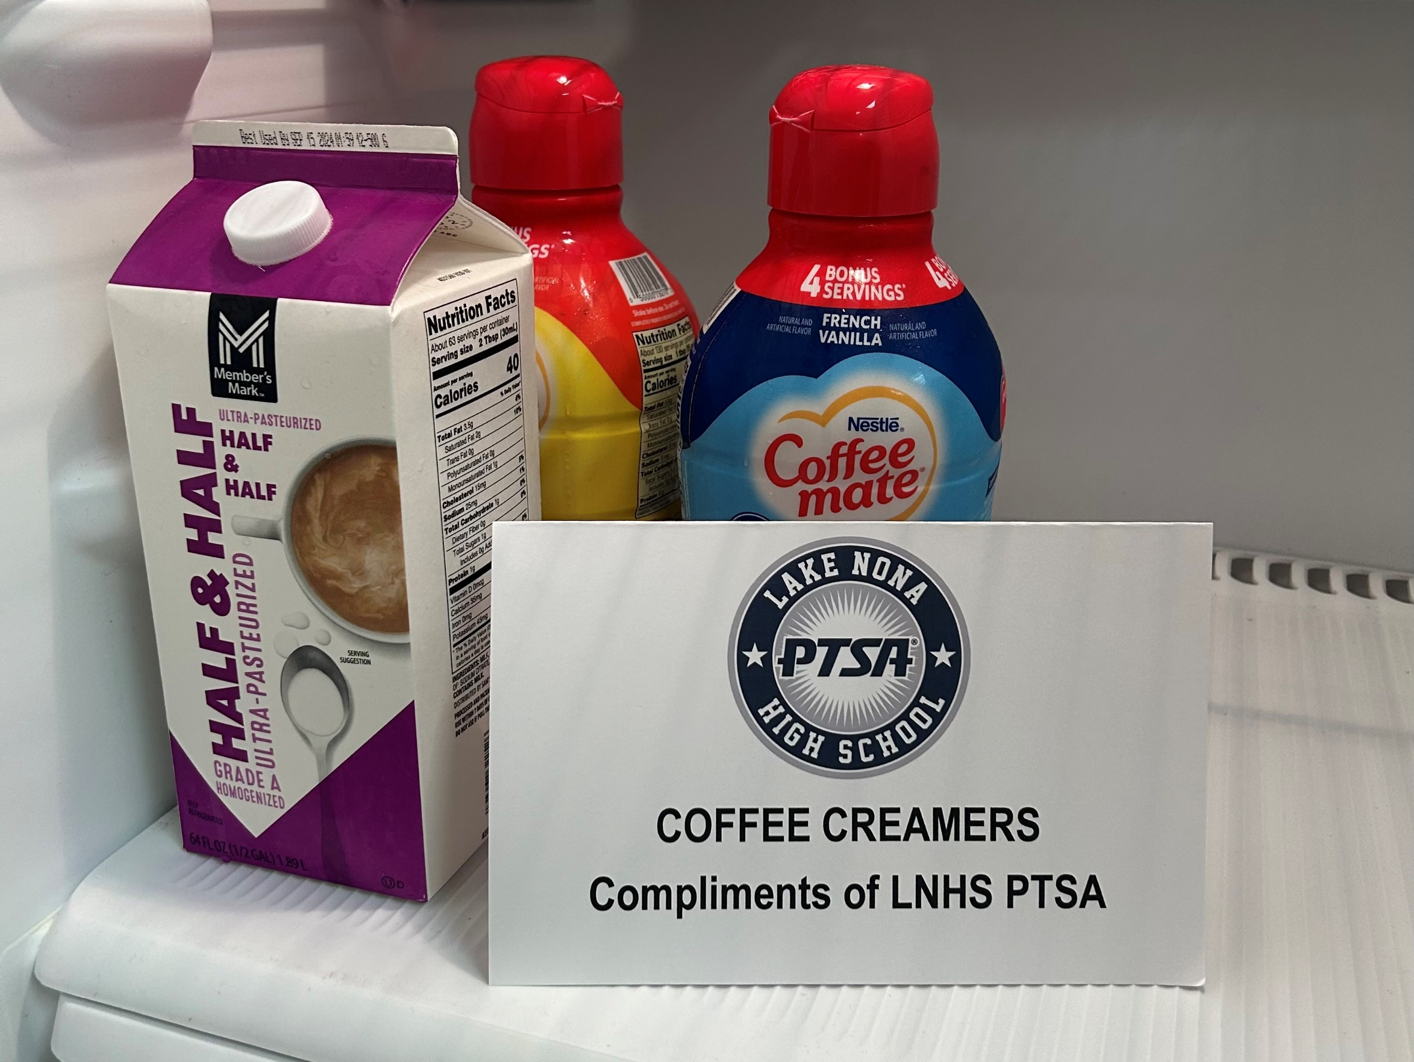
Coffee Station
STAFF APPRECIATION
Past Events
(October-January)
Upcoming Events

Slide 10
LEARN WITH
LIONS
Virtual Tutoring Club

Slide 11
SENIOR SCHOLARSHIPS

Slide 12
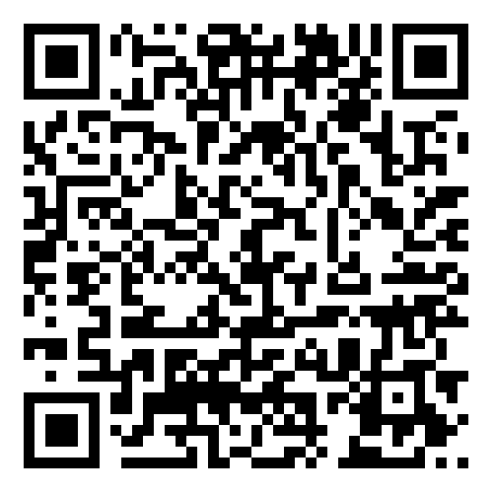
EMAIL - LNHSPTSA@gmail.com
WEBSITE - www.LNHSPTSA.com
Next Meeting - April/May TBD

